Slide 1
APPLICATION DEVELOPMEnt
ict
MOBILE
Group 26: OpenVisionAPI Front-End

Slide 2
MENU
OUR TEAM
DEMAND
01
02
OPENVISION API
DEMO
03
04
ICT
Team members
Why do we need this app
What is OpenVisionAPI
Demo app on our phones

Slide 3
MEMBERS
01
Our team
demand
Openvision
demo
ICT
TEAM

Slide 4
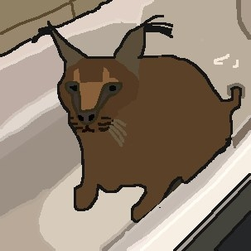
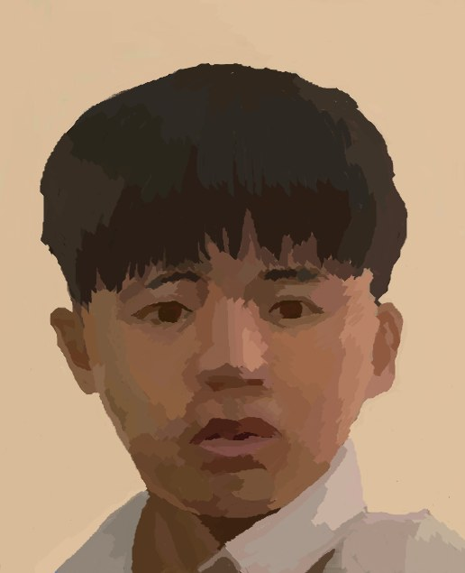

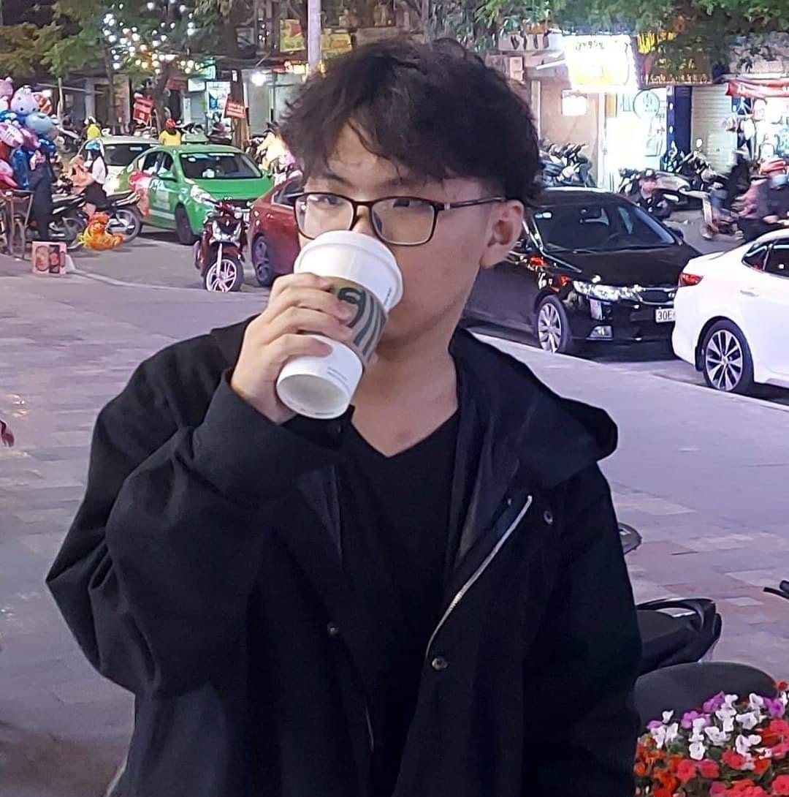

TEAM MEMBERS
BUI THE HUNG
NGUYEN QUY BAO
Ta quang hung
DO SINH HUNG
NGUYEN THANH PHUC
Our team
demand
Openvision
demo
ICT
BI12-188
BI12-047
BI12-189
BI12-180
BI9-186

Slide 5
DEMAND
02
Our team
demand
Openvision
demo
ICT
APP

Slide 6


Demand
Our team
demand
Openvision
demo
ICT
Hey Papa !
I’m here

Slide 7

Demand
Our team
demand
Openvision
demo
ICT
What is this?
That is a cactus

Slide 8
Demand
Our team
demand
Openvision
demo
ICT
What is cactus in French?
C’est un cactus

Slide 9
Demand
Our team
demand
Openvision
demo
ICT
Hey Papaaaaa !
I’m hereeeeeee

Slide 10
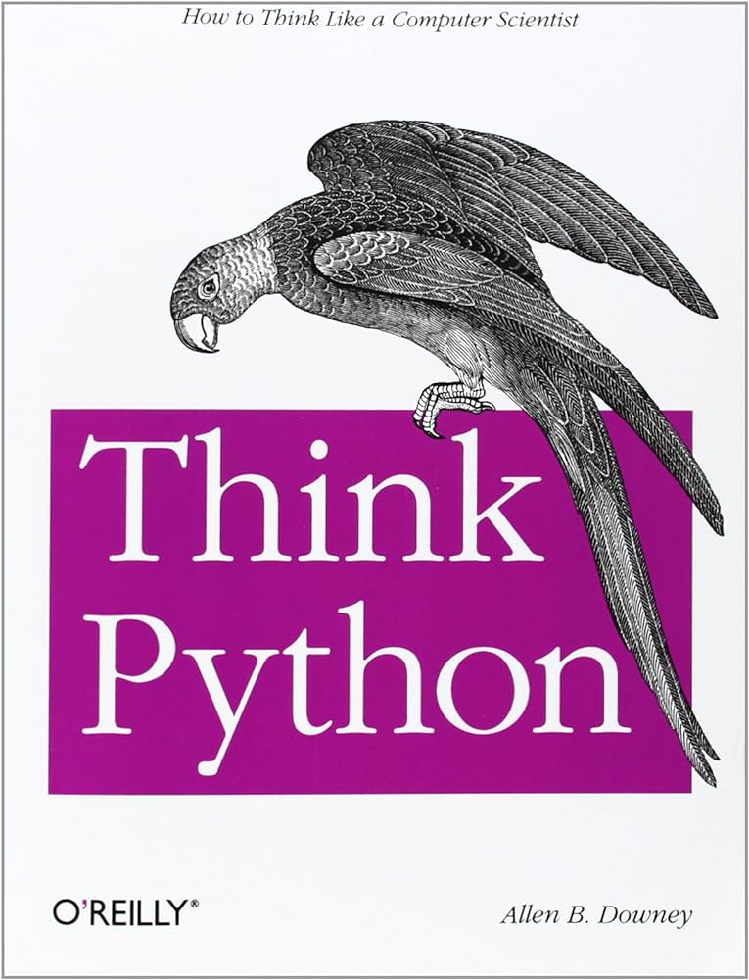
Demand
Our team
demand
Openvision
demo
ICT
What is this?
That is a book

Slide 11
Demand
Our team
demand
Openvision
demo
ICT
What is book in French?
C’est une livre

Slide 12
Demand
Our team
demand
Openvision
demo
ICT
Hey Papaaaaa !
What do you want?????

Slide 13

Demand
Our team
demand
Openvision
demo
ICT
What is thissssssss?
That is my slush fund

Slide 14
Demand
Our team
demand
Openvision
demo
ICT
What is thissssssss?
Whattttt?? Where did u get that

Slide 15
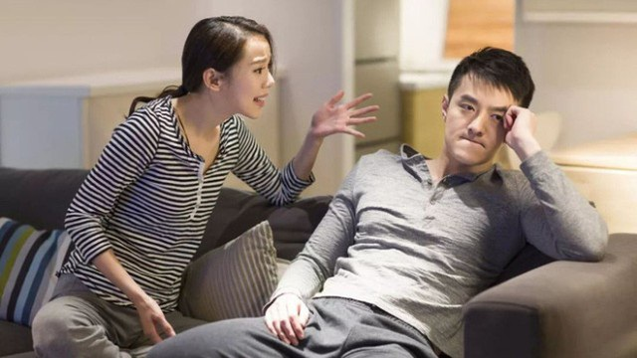
Demand
Our team
demand
Openvision
demo
ICT

Slide 16
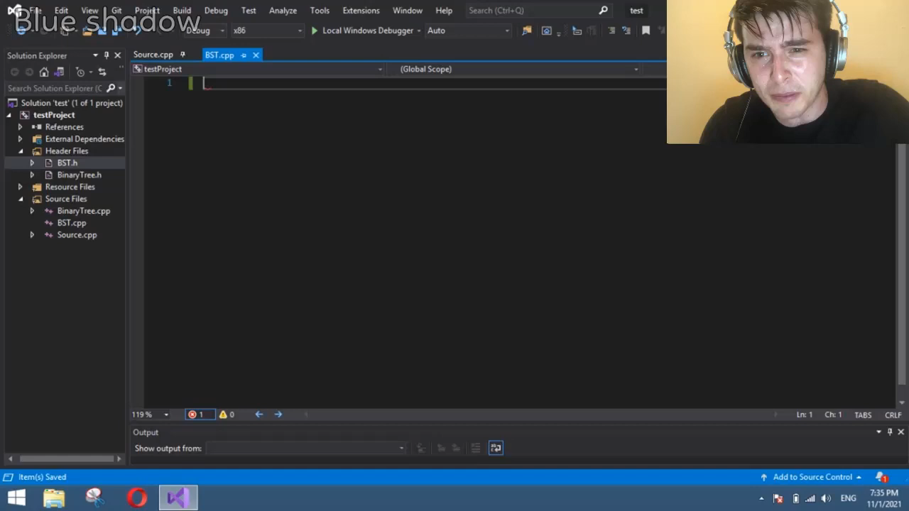
Demand
Our team
demand
Openvision
demo
ICT

Slide 17



Demand
Detect objects
Learning new words
Learning pronunciation
Our team
demand
Openvision
demo
ICT
We use OpenVision’s API to be able to detect objects
After detect object, we can see how it is written in different languages
We use Google Text to Speech ( TtS )

Slide 18
OPENVISON
03
Our team
demand
Openvision
demo
ICT
WHAT IS

Slide 19
Open vision api
- It is an open source computer vision API based on open source models.
- It provides a simple and easy-to-use interface for performing a variety of computer vision tasks, including object detection, image classification, and image segmentation.
- It supports a variety of deep learning frameworks, including TensorFlow, PyTorch, and TensorFlow Lite. It also supports a variety of hardware accelerators, including CPUs, GPUs, and edgeTPUs.
Our team
demand
Openvision
demo
ICT

Slide 20
DEMO
04
Our team
demand
Openvision
demo
ICT
APP

